Slide 1

Electric Fields
Dipoles
Parallel Plates
Etc.

Slide 2
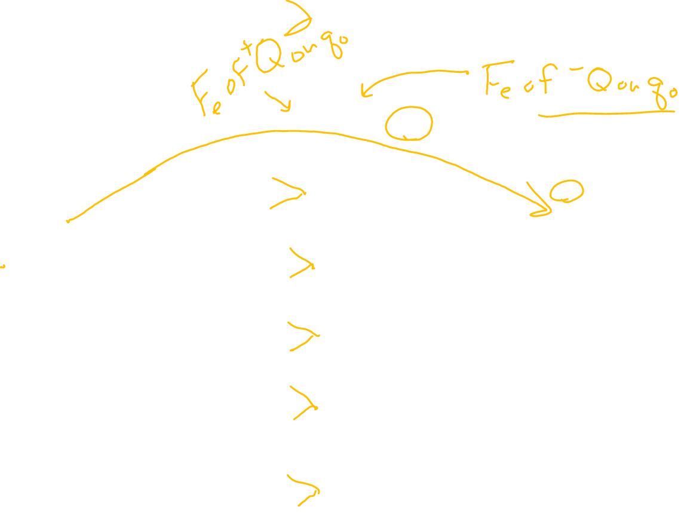
Electric Dipole
Note: An electric dipole consists of two charges equal in magnitude and opposite in sign.
+Q
F
-Q
+q_{o}
_
_
_
_
+
+
+
_
+
_
_
+
+
+
_
_
_
+
+
+
_
_
+
_
_
_
+
+
+
_
_
+
+
_
_
+
+
Note: Force on a test charge(q_{o}) is always tangent the field lines, and is the vector sum of the forces due to both charges of the dipole acting on it.

Slide 3

Electric Fields and Conductors
E
At equilibrium, excess charges will reside on the surface of a conductor.
The electric field is zero at any point within a conducting material at equilibrium.
Charge within a conductor is shielded from external electric fields because they begin or terminate on the surface where excess charges reside.
+
+
+
+
+
+
+
+
+
+
+
+
+
+
+
+
+
+
No E-Field inside conductor
Faraday’s Cage

Slide 4
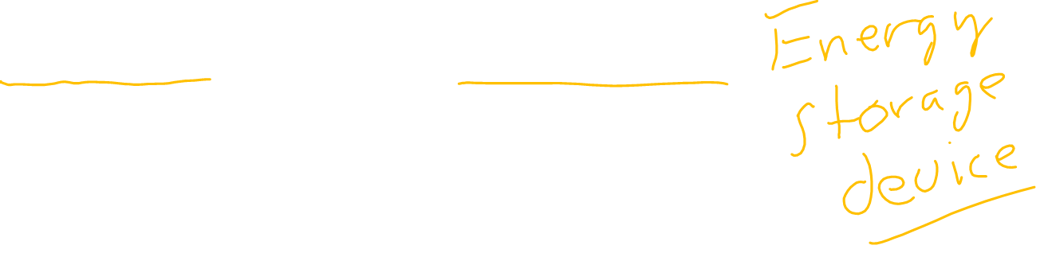
Parallel Plate Capacitor
The parallel plate capacitor is an energy storage device used in all kinds of electronics.
Field lines in a parallel plate capacitor are evenly spaced and parallel to one another, indicating a uniform electric field.
+
+
+
+
+
+
+
+
-
-
-
-
-
-
-
-
E

Slide 5
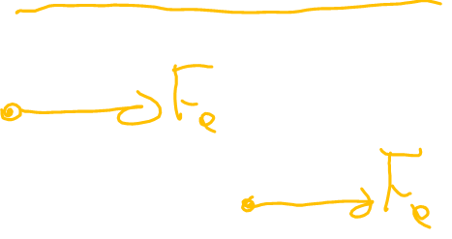

Electrostatic Force and Distance
For parallel plates:
  The strength of the field is constant from one plate to the other.
  Since E does not vary, the force will be constant.
$${F }_{e}$$

Slide 6
Force and Electric Field Strength vs. Distance
Point Charge Parallel Plate
Force
Force
Distance
Distance
E-Field Intensity
E-Field Intensity
Distance
Distance

Slide 7
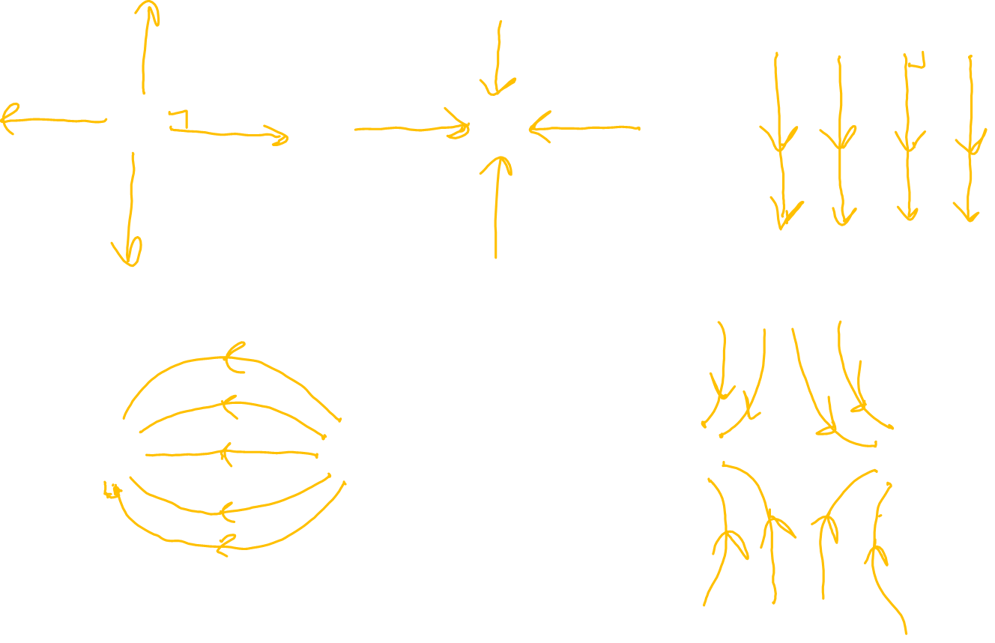
Do Now: Draw the electric field lines for the following configurations.
+
+
+
+
+
+
+
+
+
-
- - - - - - - - -
-
+
-
-

Slide 8

Example (Millikan Oil Drop Exp.)
An oil drop is negatively charged and weighs 8.5 x 10⁻¹⁴ N. The drop is suspended in an electric field intensity of 5.3 x 10¹ N/C.
What is the charge on the drop?
Since F_{net} = 0N, F_{e} = F_{g}
Eq = mg
q = mg/E = F_{g}/E
q = 8.5 x 10⁻¹⁴ N/53 N/C
q = 1.6 x 10⁻¹⁵C
How many electrons is that?
~10,000 electrons
+ + + + + +
F_{e} = Eq
-
F_{g} = mg
E
- - - - - -

Slide 9
Examples from the Web
http://www.cco.caltech.edu/~phys1/java/phys1/EField/EField.html
http://phet.colorado.edu/sims/charges-and-fields/charges-and-fields_en.html

Slide 10
Key Ideas
Electric fields exists around any conductor or insulator that contains a charge.
The electric field intensity is a measure of the force on a test charge placed in the field.
The strength of the field is proportional to the density of field lines.
Field lines are perpendicular to all charged surfaces.
The electric field is always directed away from positive charges and towards negative charges.

